Slide 1

Smart Traffic Management System
Real-Time Traffic Updates & AI-Based Solutions

Slide 2
The Growing Traffic Problem in Urban Areas
Traffic Congestion
Lack of Monitoring
Ever-increasing congestion on city streets
Absence of real-time traffic monitoring systems
Inefficient Signal Timers
Negative Impact
Fixed timers cause delays and frustration
Leads to delays, accidents, and pollution

Slide 3
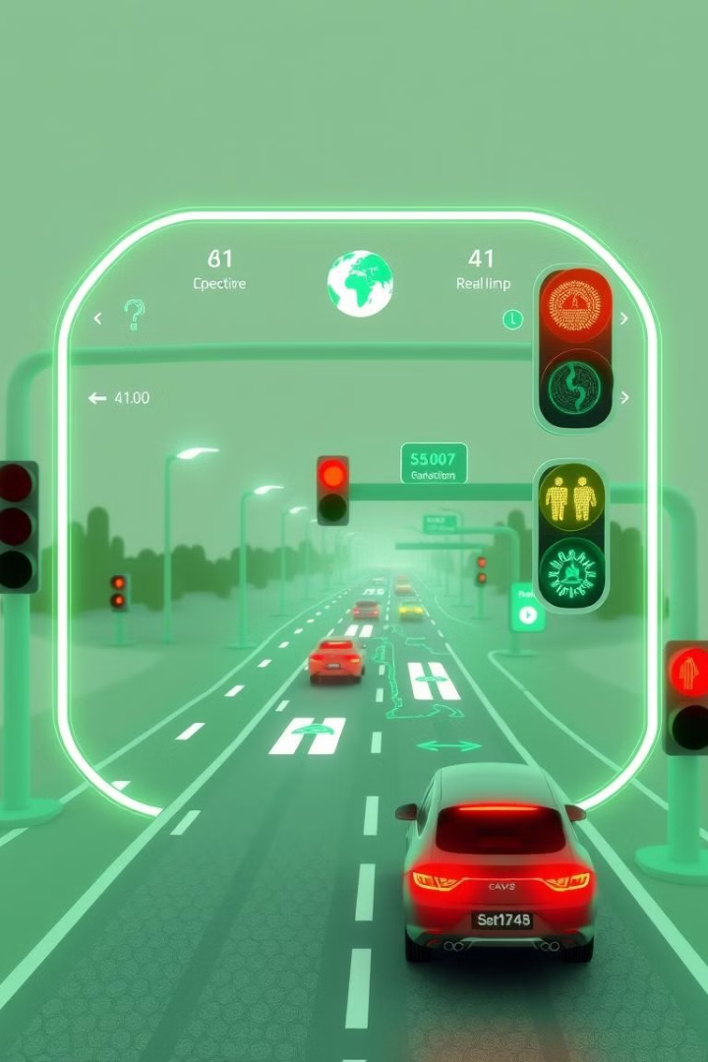
Introducing Smart Traffic Management
Live Traffic Monitoring
Google Maps API integration for live data
AI Traffic Lights
AI-based traffic light system for optimization
Issue Reporting
Report traffic issues in real-time
Route Suggestions
Alternate route suggestions for quicker commutes

Slide 4
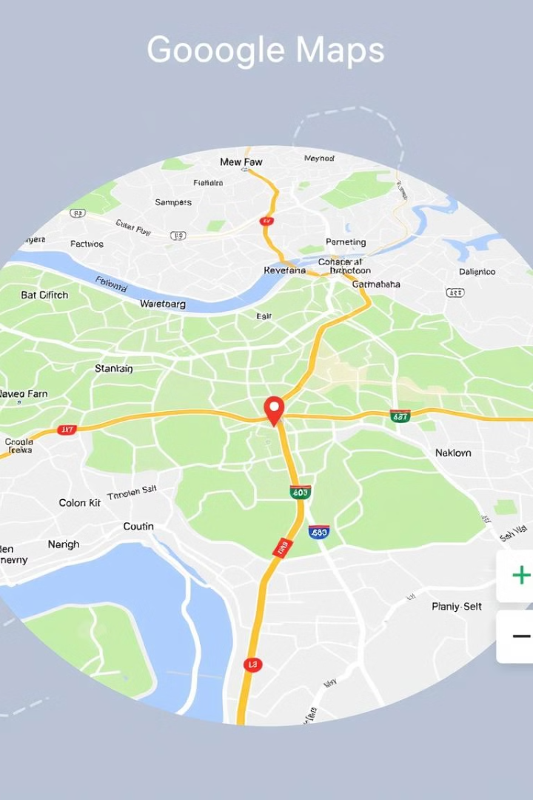



Real-Time Traffic Monitoring
Google Maps API
Integrates for live updates
Congestion Levels
Shows road congestion dynamically
Roadblocks
Displays accidents and closures

Slide 5



User-Powered Traffic Issue Reporting
Report Issues
1
Congestion, accidents, blockages
Crowdsourced Data
2
Improves route planning
Road Safety
3
Reduces delays, increases safety

Slide 6




AI-Driven Traffic Signal System
Adaptive Signals
Timing based on live traffic
Sensor Data
Manages intersections
Reduced Waiting
Less waiting time for drivers

Slide 7
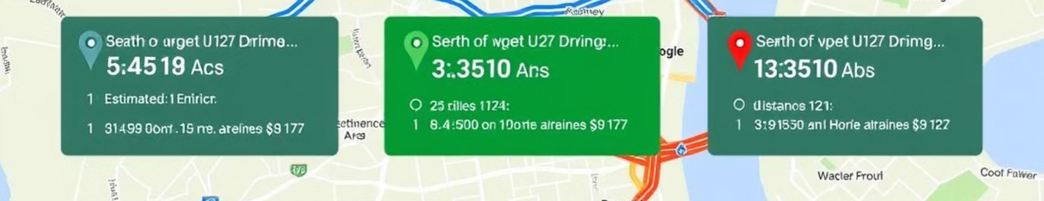
Smart Route Planning for Faster Travel
Optimal Routes
Real-Time Data
Saves Time
Google Maps API integration
Considers traffic congestion
Reduces fuel consumption

Slide 8





Technology Behind Our System
Frontend
HTML, CSS, JavaScript
Mapping
Google Maps API
Styling
Tailwind CSS
Interactivity
JavaScript

Slide 9



Transforming Traffic, One Signal at a Time
2
User Participation
1
Real-Time Monitoring
AI Signal Control
3
Faster, smarter urban mobility

Slide 10

Transforming Traffic, One Signal at a Time
Ready to revolutionize traffic? Join us!

